Slide 1
The Greater Manchester Economic Update Event
Subrahmaniam Krishnan-Harihara
Deputy Director - Research & Information Systems GM Chamber
Rupert Greenhalgh
Head of Business Intelligence
The Growth Company

Slide 2
What is the Quarterly Economic Survey (QES)?
The Greater Manchester QES is part of the UK’s largest and most reliable business confidence survey
GM Chamber administers the survey in GM and co-ordinates the North West QES, which goes to the BCC.
National QES results are used by the likes of HM Treasury, Bank of England and OECD for decision making.
GM QES is the primary source of economic intelligence in Greater Manchester.
The findings are presented to Greater Manchester Combined Authority's Economic Resilience Group and the 10 councils in GM for local decision making.
From the QES results, we calculate the GM Index^{TM,} a composite economic indicator for the GM Economy.

Slide 3











Q3 results show a weakening in many indicators but there are sectoral variations
Domestic demand declined
Export sales remain weak
Cash positions have declined further
Capacity utilisation remains stable
Recruitment activity is similar to previous quarter but has weakened since 2024
Recruitment difficulties persist
Business investment remains low
High inflation remains the primary businesses concern

Slide 4
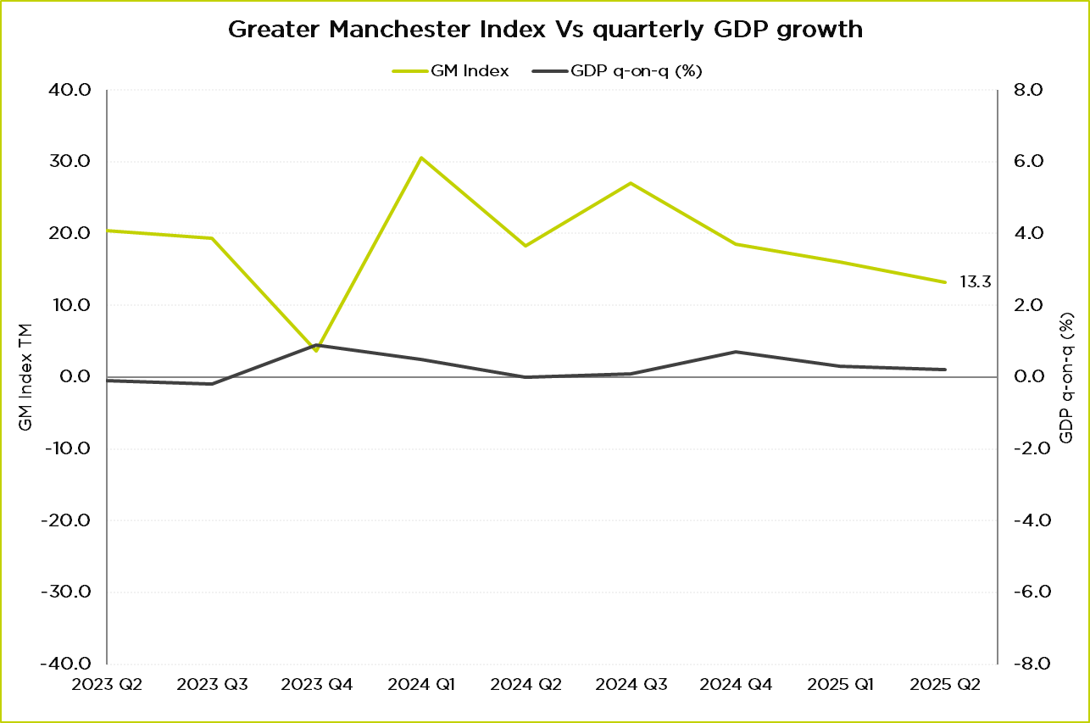
Where are we now?
GM Index in Q3 2025: 13.3
GDP growth of 0.3% in Q2 2025 (0.7% in Q1)
Weakening seen in July and August
Inflation remains above target: CPI of 3.8% in August and September
Pessimistic outlook in the lead up to the budget.
PMI indices for September:
  Services: 50.8
  Manufacturing: 46.2
  Construction: 46.2
Source: GMCC QES, ONS GDP Quarter on Quarter growth: CVM SA %

Slide 5
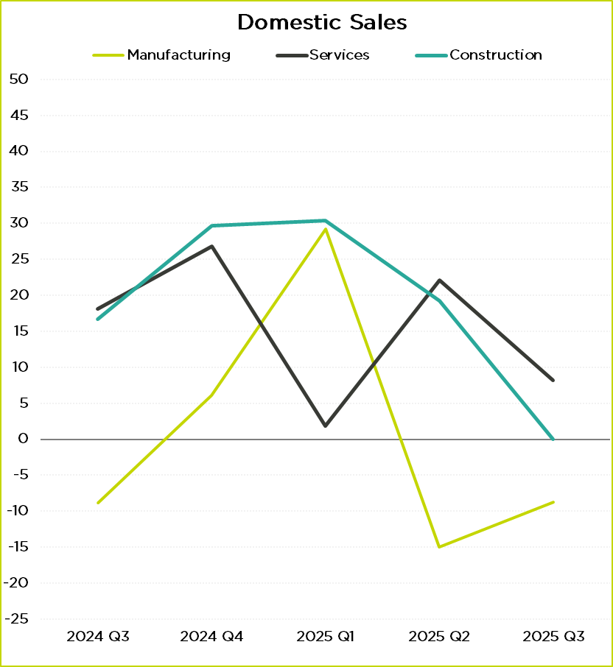
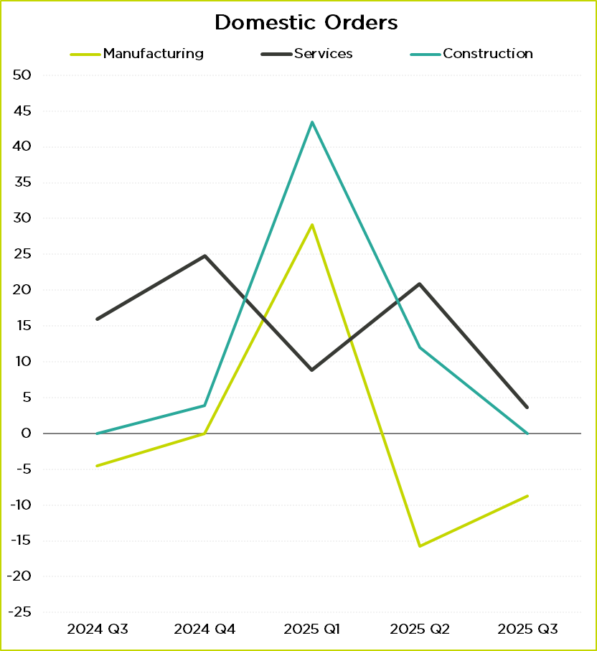
Domestic Demand: sectoral
Source: GMCC QES
Source: GMCC QES

Slide 6
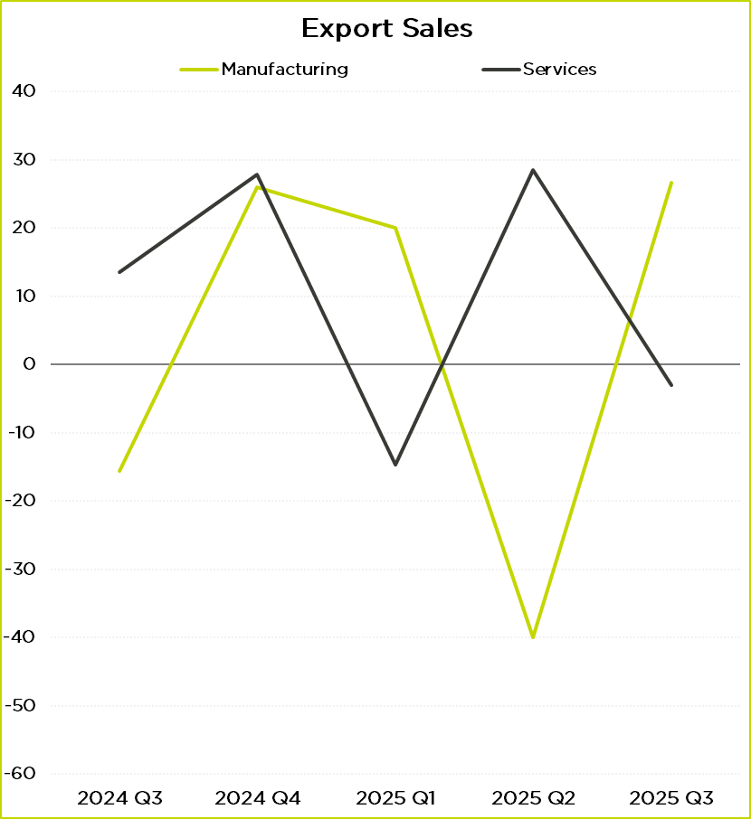
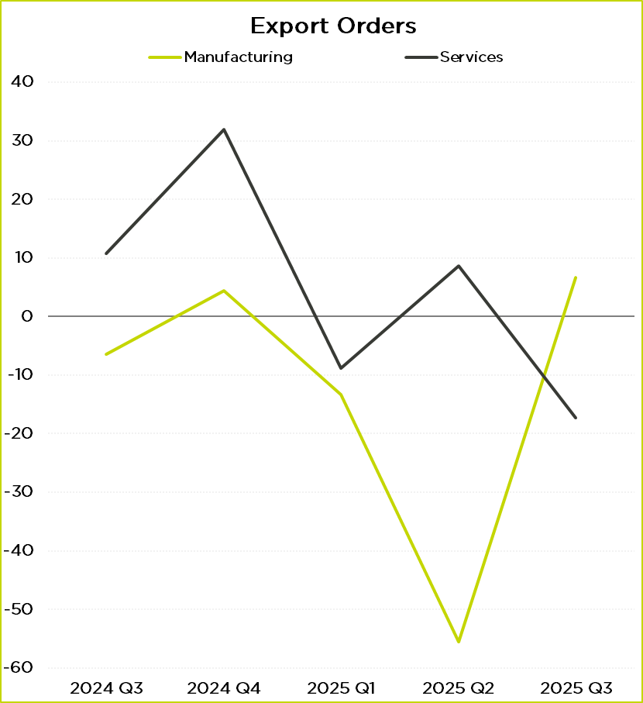
Export demand: sectoral
Source: GMCC QES
Source: GMCC QES

Slide 7
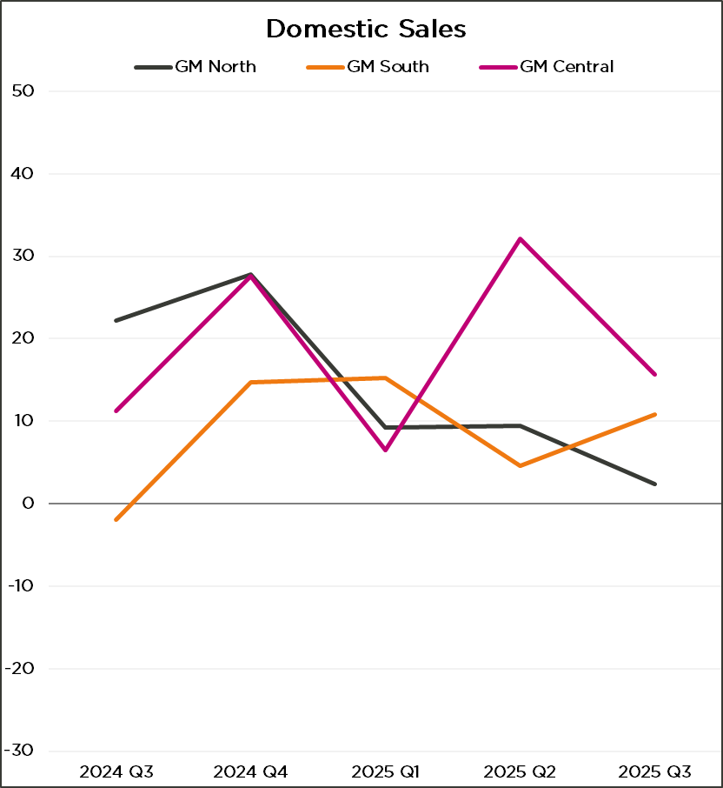
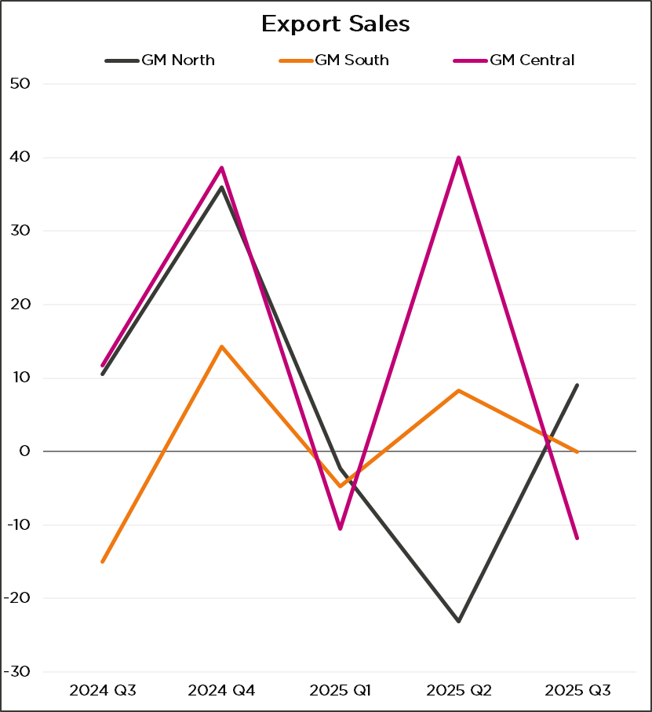
Demand: regional
Source: GMCC QES
Source: GMCC QES

Slide 8
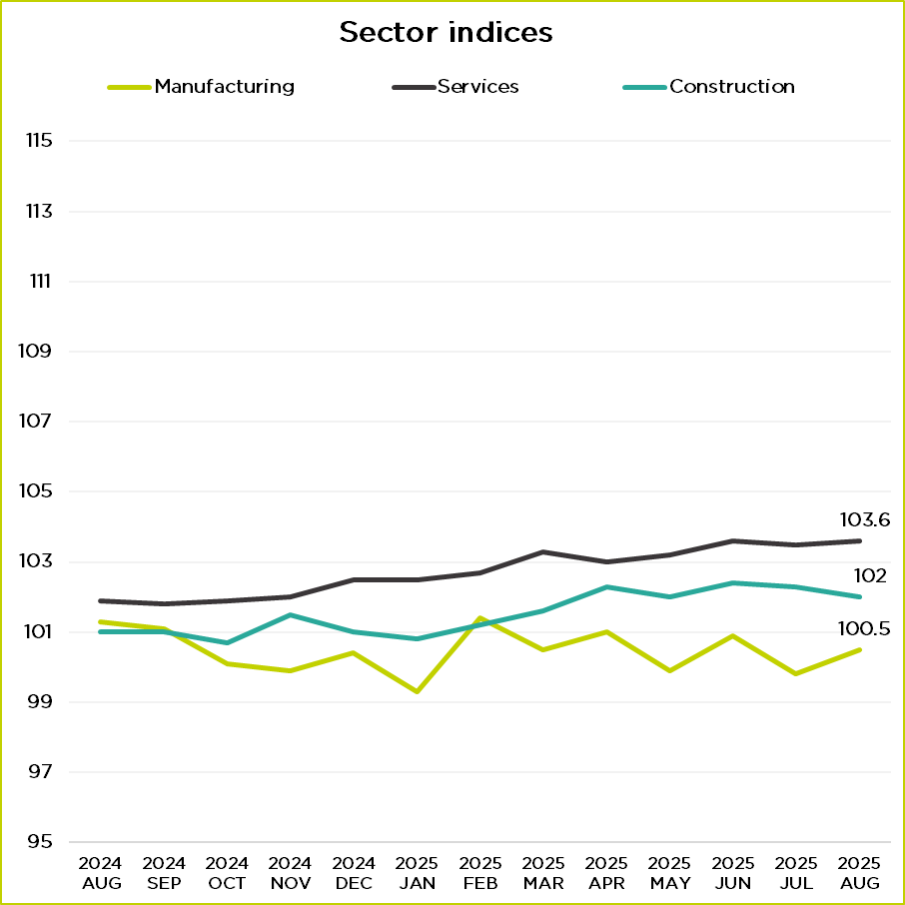
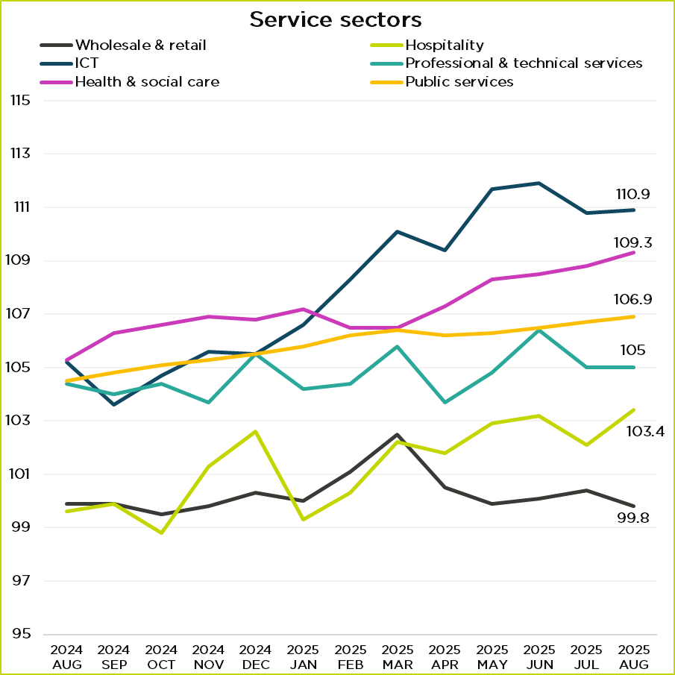
UK Sector Performance (indices)
Source: ONS
Source: ONS

Slide 9
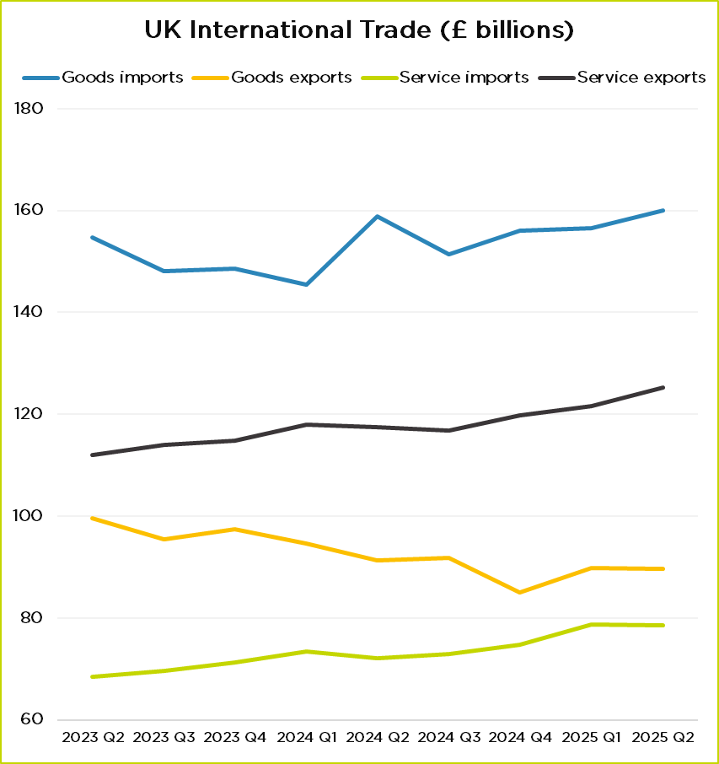
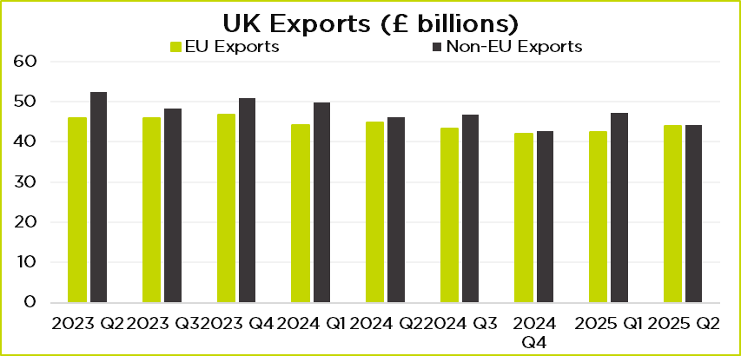
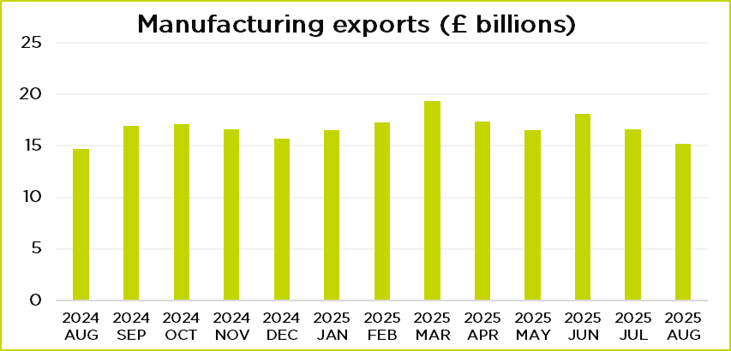
UK International Trade
Source: ONS
Source: ONS

Slide 10
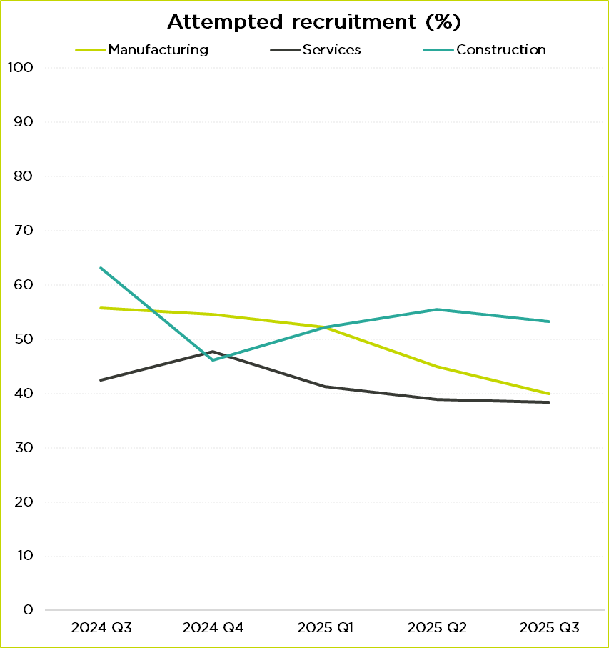
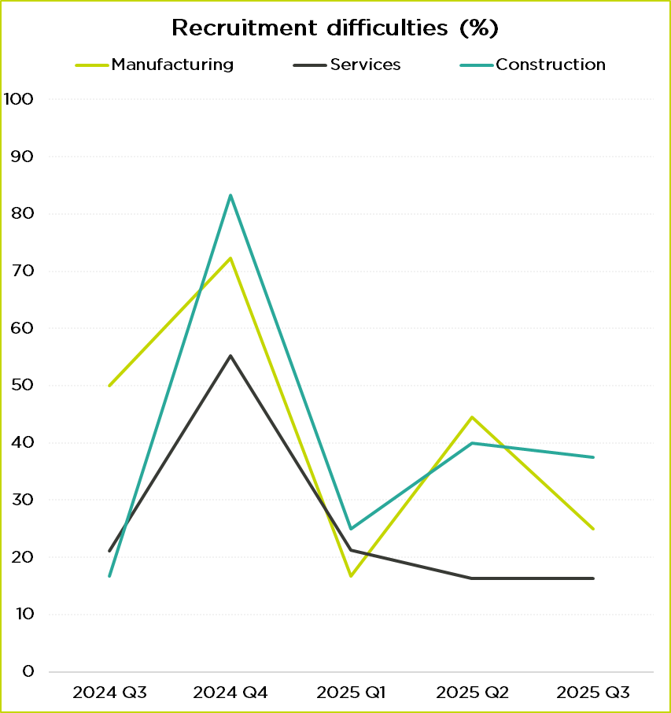
Recruitment
Source: GMCC QES
Source: GMCC QES

Slide 11
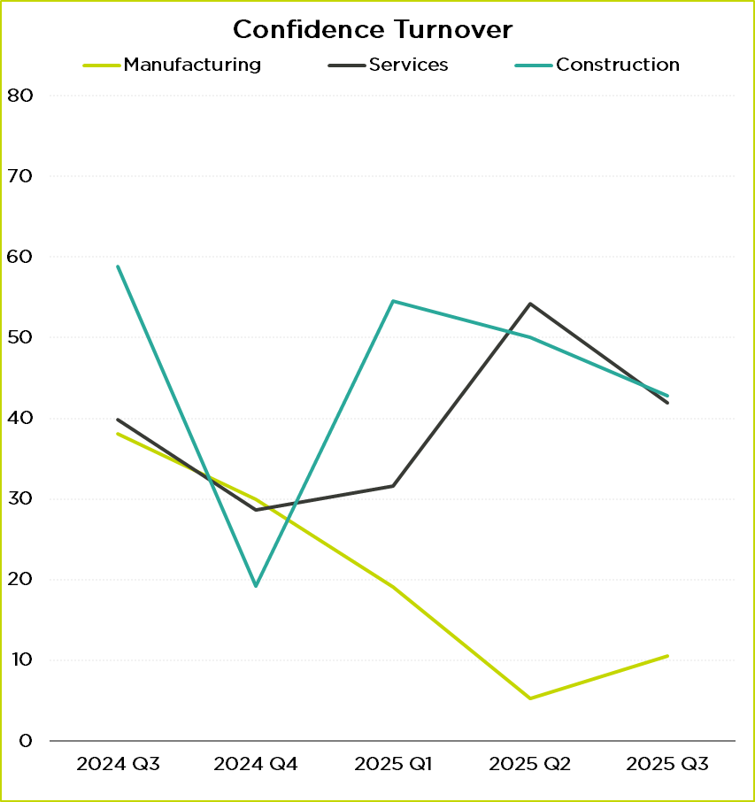
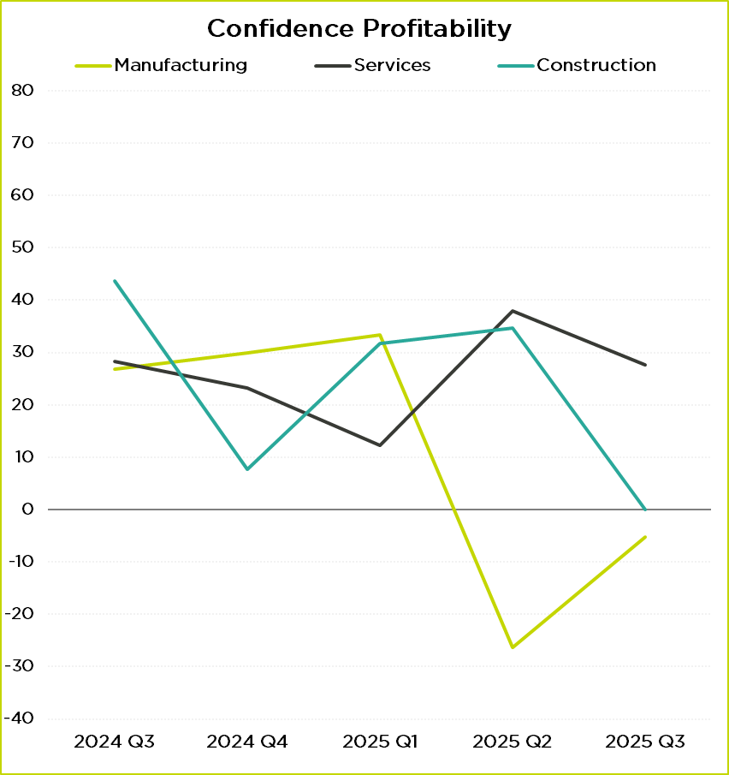
Business Confidence
Source: GMCC QES
Source: GMCC QES

Slide 12
Business concerns – Q3 2025
“Steps taken by the Chancellor / government (and future steps being discussed in the media as potentials) have led to significant wage inflation reluctance to invest and investment confidence dented.”
“The government have increased wages Nat insurance etc far too much and business are struggling to maintain it.”
“Growth needs to be a priority with the removal of barriers to facilitate.”
“I have serious reservations about what the next budget will have in store for SME’s.”
“I have no confidence in the future given the track record so far of this govt.”
“Hospitality is not being supported at all no help from government. Higher fuel utility and beer prices with less footfall.”
“Footfall is reasonable but average spend per customer has decreased. We have cut costs wherever possible but these have been negated by increased wages and increased costs in raw materials.”
“It’s fine. If there was a lower rate of VAT [for hospitality] we would grow at a quicker rate, speed up expansion and recruitment plans and deliver more money to HMRC.”
“Good to see positive action by Greater Manchester Combined Authority.”
Source: GMCC QES

Slide 13
Q&A

Slide 14


GC SITUATION REPORT AND
QUARTERLY BUSINESS SURVEY RESULTS
QUARTERLY DATA FOR 2 JULY 2025 TO 2 OCTOBER 2025
|
atharva.joshi@growthco.uk
gautham.maniyan@growthco.uk
https://www.growthco.uk/what-we-do/gc-business-survey

Slide 15
What is the Situation Report?
The Growth Company’s Situation Report and Business Confidence Index is a dedicated monthly survey that takes the temperature of Greater Manchester businesses.
These Quarterly Business Survey results are based on 756 survey responses completed between the 2 July 2025 and 2 October 2025 by clients from the GM Business Growth Hub and MIDAS.

Slide 16
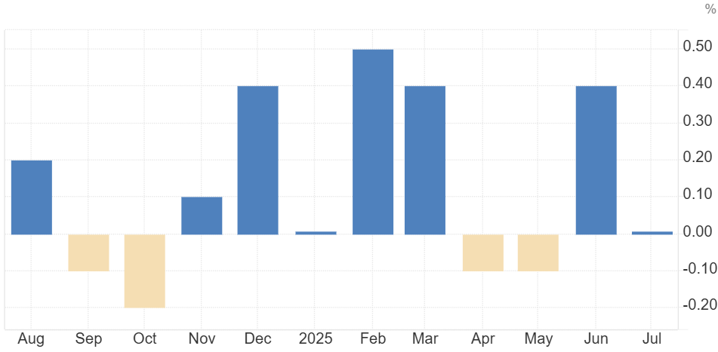
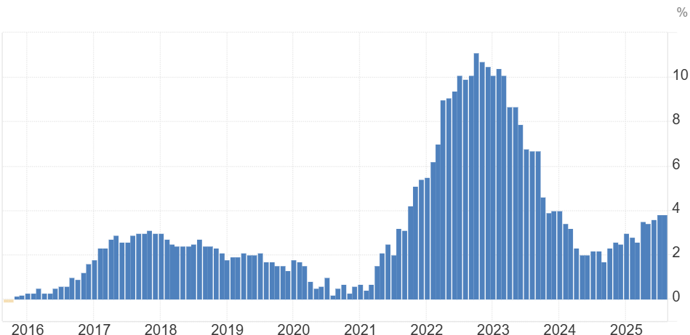
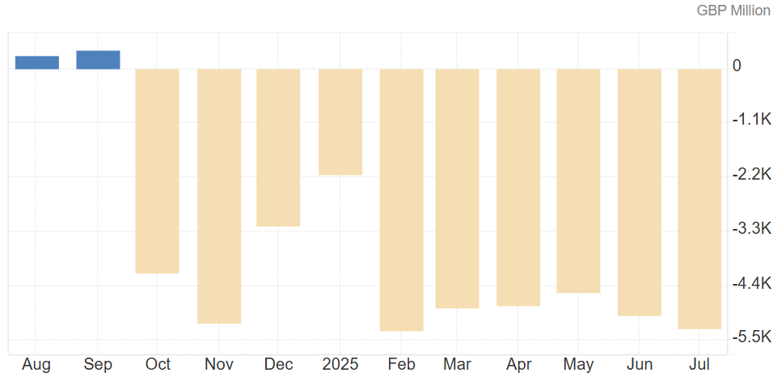
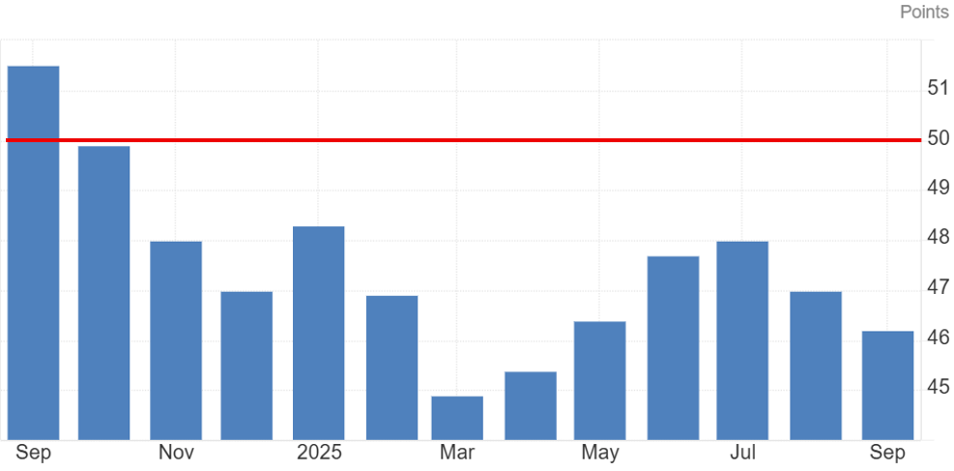
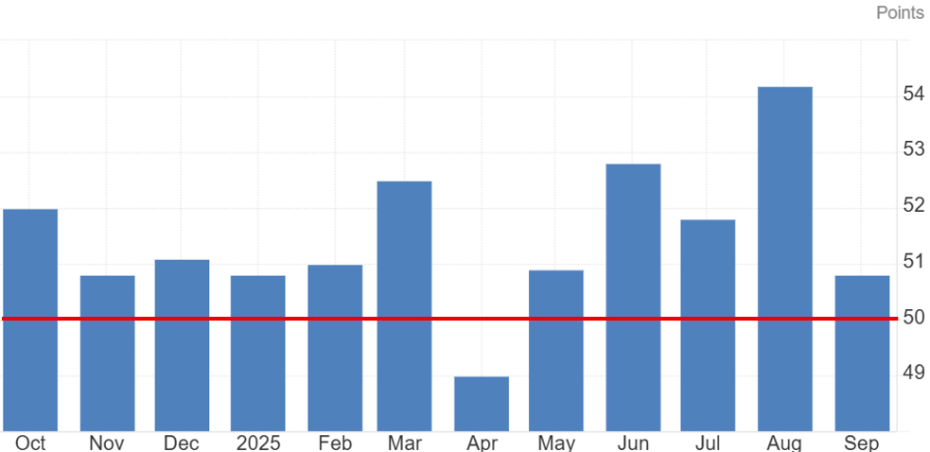
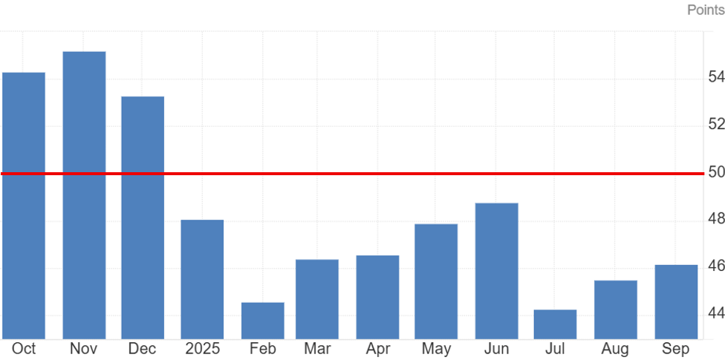


ECONOMIC CONTEXT
UK GDP stalled in July 2025 | UK CPI - Inflation steady at 3.8% in August 2025 | UK trade deficit widens in July 2025 (Latest)
The S&P Global UK Manufacturing PMI 46.2 | The S&P Global UK Services PMI 50.8 | The S&P Global UK Construction PMI 46.2

Slide 17
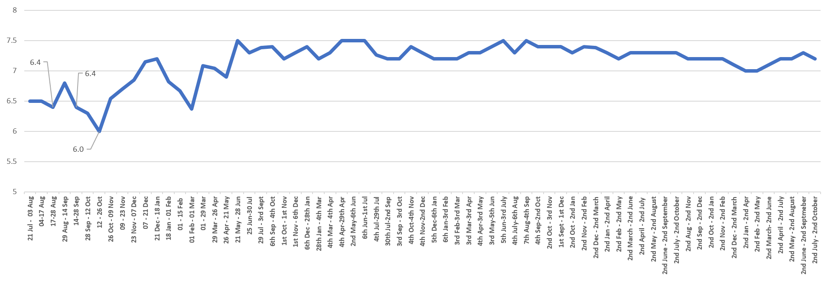
BUSINESS CONFIDENCE INDEX (1=LOW, 10=HIGH)
Confidence remains steady but fragile, with slight declines suggesting cautious optimism. Sectors like Business & Professional Services and remain more confident, while Green Tech and Engineering show vulnerability

Slide 18
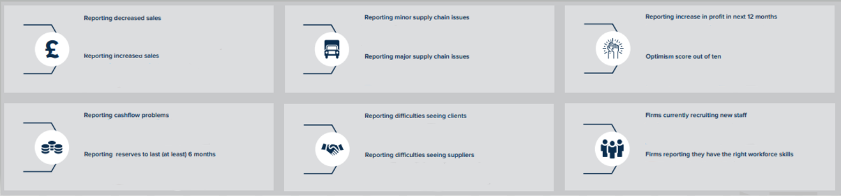












BUSINESS SURVEY HEADLINES
 Current Month Previous month
SALES SENTIMENT | SUPPLY CHAIN ISSUES | FUTURE PROFIT SENTIMENT
CASHFLOW & RESERVES | ACCESS TO CLIENTS | RECRUITMENT

Slide 19
BUSINESS SURVEY HEADLINES

Slide 20
ANNEX:
DETAILED FINDINGS, TIMESERIES AND RESPONSE RATES

Slide 21
ANNEX: ORGANISATION GROWTH SURVEY RESULTS DETAIL
Previous survey results shown in brackets - note rounding on all values
GROWTH, CONFIDENCE AND INVESTMENT | MAIN IMPACTS AND FINANCIAL RESILIENCE | BUSINESS CHALLENGES AND SUPPORT NEEDS
The GC Business Confidence Index (GC-BCI) is a ranking (1 low to 10 high) of how confident businesses are on their growth prospects for the year ahead. GC Business Confidence Index (GC-BCI) for September 2025 stood at 7.2 out of 10, down slightly from 7.3 in August. Confidence levels are above average for Business Financial & Professional Services, Construction, DCTs and Hospitality, and lower than average in Retail, Green Tech, Life Sciences, and Engineering. Current sales. 16% (unchanged) of firms reported an increase in sales, and 10% (vs 11%) reported decreased sales in the last 12 weeks. Future profits. 60% (unchanged) expect profits to increase in the year ahead. 2% (unchanged) expect profits to decrease. The sectors most optimistic about future profitability are BFPS, DCTs, Retail, Green Tech, and Hospitality. Profit sentiment was lower than average in Construction, Education, and Health Care. Investment. 33% (vs 31%) of firms expect to increase capital expenditure in the year ahead. The most optimistic sectors include Engineering, Green Tech, Hospitality, Manufacturing, and Retail. In contrast, expectations are lowest in Construction, DCTs, Education, and Health Care. Workforce Development. 30% (vs 32%) of firms plan to increase investment. Sectors more likely to report an increase are Retail, Education, and Health Care. | Main impacts. 27% (vs 30%) reported rising costs as the main impact, followed by cashflow issues 12% (vs 11%), staff shortages due to recruitment difficulties 9% (vs 8%), and minor supply chain challenges 8% (unchanged). Cash reserves. 61% of firms (vs 58%) report having cash reserves to last over 6 months. Reserves were highest in Education, Construction, Engineering, Hospitality, Manufacturing, and Retail, and lowest in Green Tech and Logistics. Cashflow. 12% (vs 11%) of firms reported cashflow problems. Micro-sized firms (<10 employees) were more likely to face cashflow challenges than larger SMEs (50–249+ FTEs), with higher risk reported in DCTs, Manufacturing, and Hospitality. 2% (unchanged) of firms reported late payments. Analysis of insolvency risk for September 2025 shows increase in the total number of firms (10 or more employees) reporting heightened levels of risk: 1147 (up from 667 last month) firms have 1 flag - some risk; 57 (up from 41) have 2 red flags - medium insolvency risk; 60 (up from 21) have 3 red flags - insolvency imminent. Change in risk. The proportion of firms with a red flag rating increased +2.2 percentage point on levels in September (UK +1.0ppt). Over the last 12 months, the proportion of firms with a red flag rose by 0.1 percentage point (UK-0.7%pt) | The main challenges for businesses in the near term are accessing new domestic sales, 48% (vs 51%). This challenge is more acute in DCT, BFPS, Healthcare, Construction and Green Tech. The next most common challenges are developing new products & services 33% (vs 31%), business model change 32% (vs 31%), finances 27% (vs 25%), and workforce development 24% (vs 27%) International trade. 22% of firms (unchanged) export goods/services, with 17% (vs 16%) expanding into new markets, a trend particularly notable in the DCTs, Engineering, Manufacturing, Green Tech, and Life Sciences. 12% (vs 11%) of firms engaged in overseas trade are looking to expand in their current markets. Future support. The main areas where firms seek future support are business planning 36% (unchanged), sales & marketing 31% (vs 32%), innovation 33% (vs 32%), workforce development 30% (vs 29%) and financial advice 24% (vs 21%). Micro-size and small firms (0-9 FTEs) were more likely to indicate future support needs in business planning, sales and marketing, and innovation. Whereas firms with 10+ employees were more likely to request support in WfD and skills, recruitment, environmental impacts, & digital transformation. Environmental Impact Management. 14% (vs 12%) require assistance with managing their environmental impact. Larger SMEs and large firms were more likely than micro-size firms to specify these support needs.
RECRUITMENT, EMPLOYMENT AND SKILLS | RESEARCH, DEVELOPMENT AND INNOVATION | SOCIAL VALUE AND GOOD EMPLOYMENT PRACTICES
Recruitment: 26% (vs 28%) of firms are currently recruiting new staff. Recruitment rates (% recruiting) are higher amongst SMEs (50 to 250+ employees). By sector, recruitment is more active in BFPS, Other Manufacturing, Education, Green Tech, and Retail. Whereas, Life Sciences, Engineering, and DCTs sectors were least likely to be recruiting. Workforce skill gaps. 41% (vs 44%) reported that their existing workforce skills are fully aligned with their business plan objectives. 46% (vs 43%) indicated that skills are only partially at the required level, and 2% (unchanged) stated that their workforce skills are not at the right level (11% said ‘don’t know’). Smaller SMEs were more likely to report gaps in sales & customer skills, whilst firms with 50+ FTEs were more likely to report gaps in managing/motivating staff, team working, and management & leadership skills. The main technical skill gaps: Specialist technical skills 29% (vs 30%), advanced IT skills 16% (vs 14%), solving complex problems 8% (vs 10%), and knowledge of specific products/services 8% (vs 9%). The main people and practical / personal skill gaps: Sales and selling 23% (unchanged), motivating staff 14% (vs 13%), customer handling skills 11% (unchanged), and time management 9% (unchanged). | Innovation activities in last year. 35% (vs 33%) have invested in new / significantly improved services, 29% (vs 27%) in R&D, 21% (vs 20%) new business practices, 14% (vs 19%) introduced new / significantly improved goods, and 12% (vs 11%) have invested in improved production methods. Digital innovation. 10% (unchanged) have invested in the acquisition of digital products, and 5% (unchanged) made investments in the acquisition of new machinery especially, in the Manufacturing and Engineering sectors. Future innovation. 35% (vs 31%) of firms are looking to increase investment and R&D in future, highest in BFPS, Life-Sciences, DCTs, and Manufacturing. 30% (vs 33%) said they were likely to invest in workforce development, highest within the Education, Green Tech, Retail, DCT, and Health Care. Digital Transformation. 19% (unchanged) firms are looking to invest in digital transformation, highest within the Construction, Manufacturing & Engineering, and Retail sectors; and less likely in Health Care, Life Sciences, Green Tech, Hospitality, and Education. AI Adoption: 43% (vs 44%) have adopted AI into business. Firms were most likely to have implemented AI in data processing and analytics, sales and marketing, replacing customer support, and automating routine processes. | Organisations were asked if they had/or intended to have the following: Guaranteed at least 16 hours of work per week. 56% (vs 59%) said this currently applies, and 26% (vs 21%) said they are likely to consider in future. Paying employees the Real Living Wage. 51% of firms (vs 55%) paid the RLW, while 30% (vs 24%) indicated they are likely to implement it in the future. Investing in leadership. 45% (vs 44%) said that they are investing in leadership, while 39% (vs 37%) indicated they are likely to do so in future. Promoting healthy work practices. 44% (unchanged) said this currently applies, while 30% (vs 28%) indicated they are likely to do so in future. Offering flexible working options to employees. 42% (vs 45%) said this currently applies, and 35% (vs 31%) said likely to implement in the future. Looking to increase the diversity of the workforce. 39% (unchanged) of firms said this currently applies, 37% (vs 34%) said likely to include this in the future. Involving employees in the overall direction of the business. 36% (unchanged) said this currently applies. 38% (vs 34%) said likely to do so in future.

Slide 22
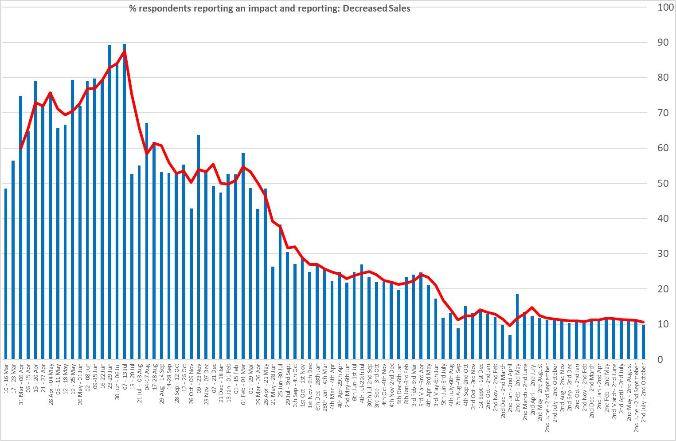
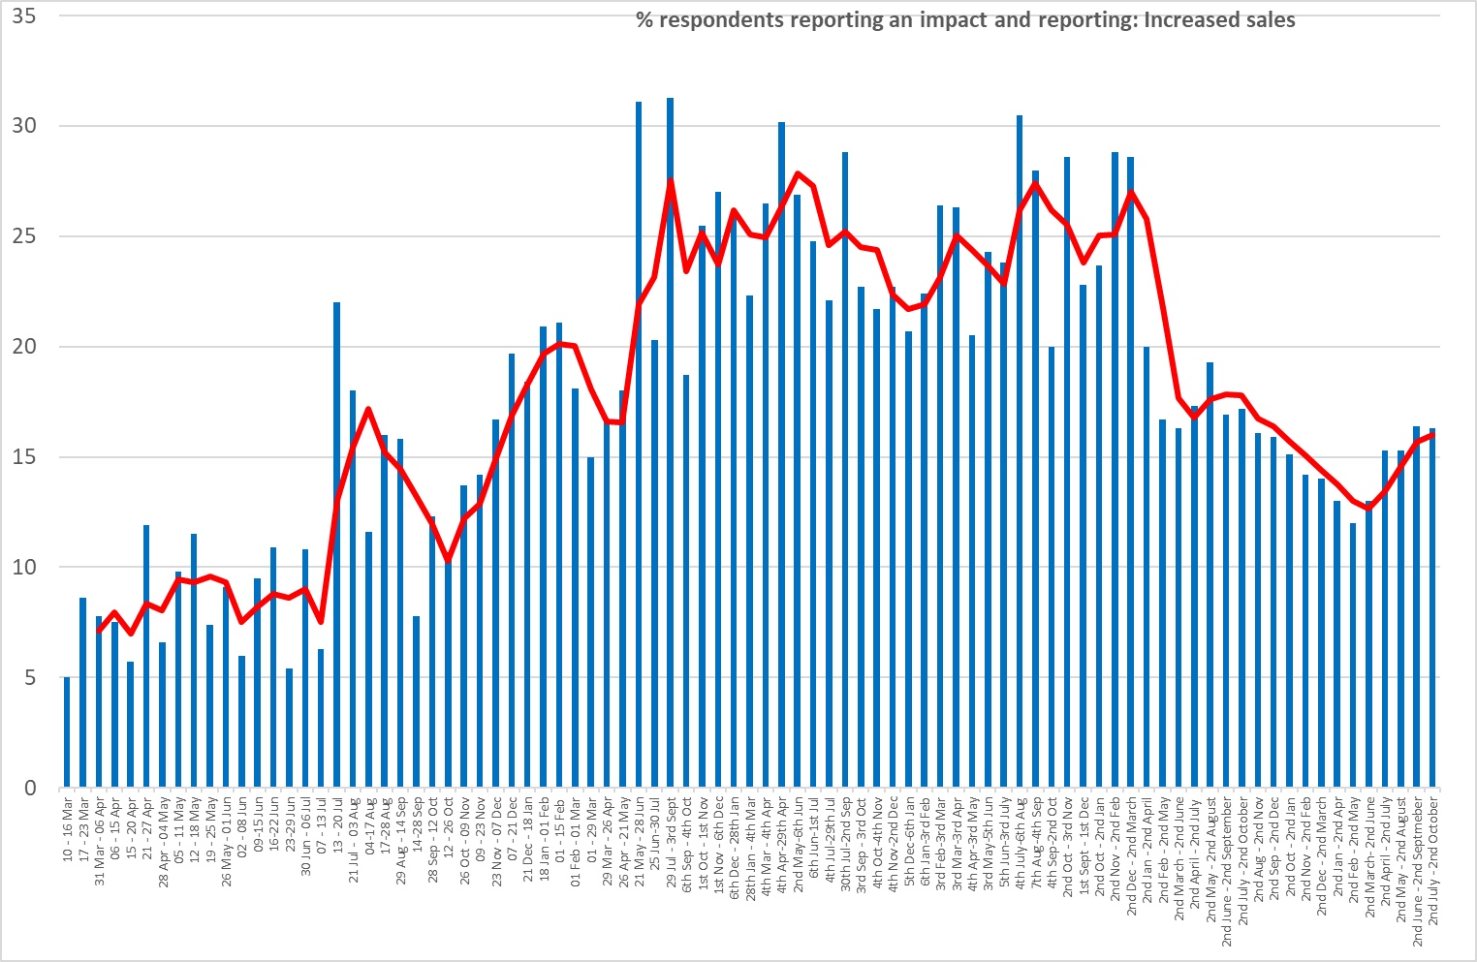
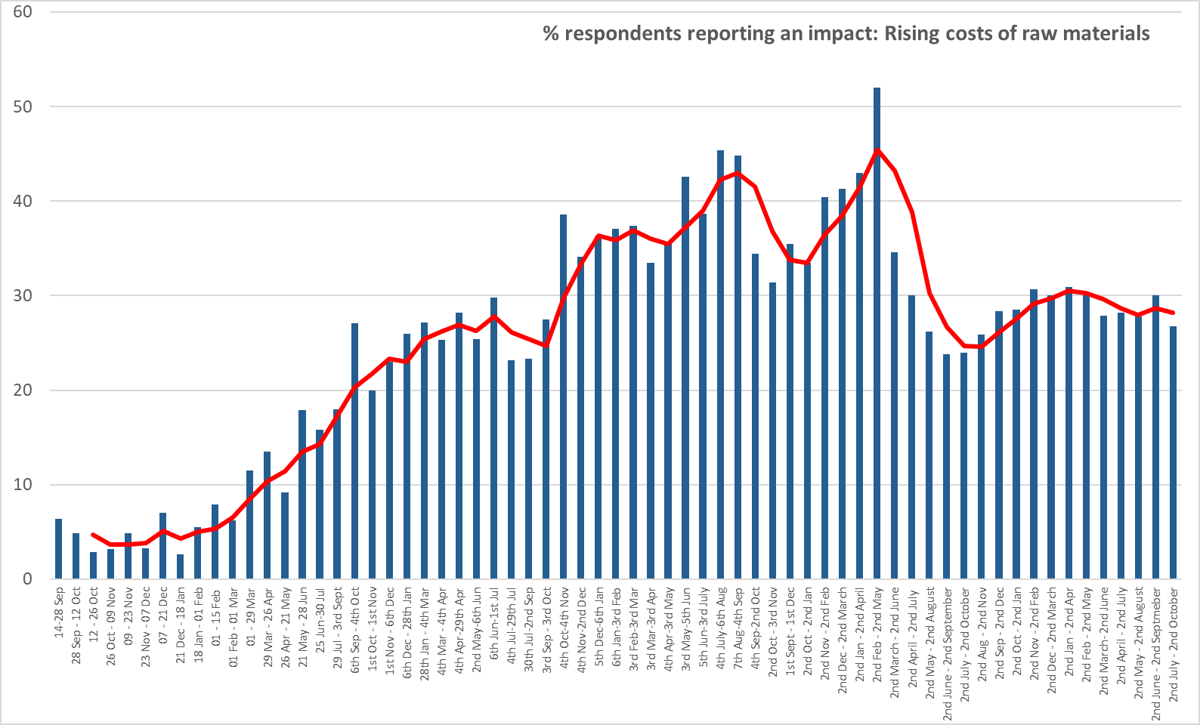
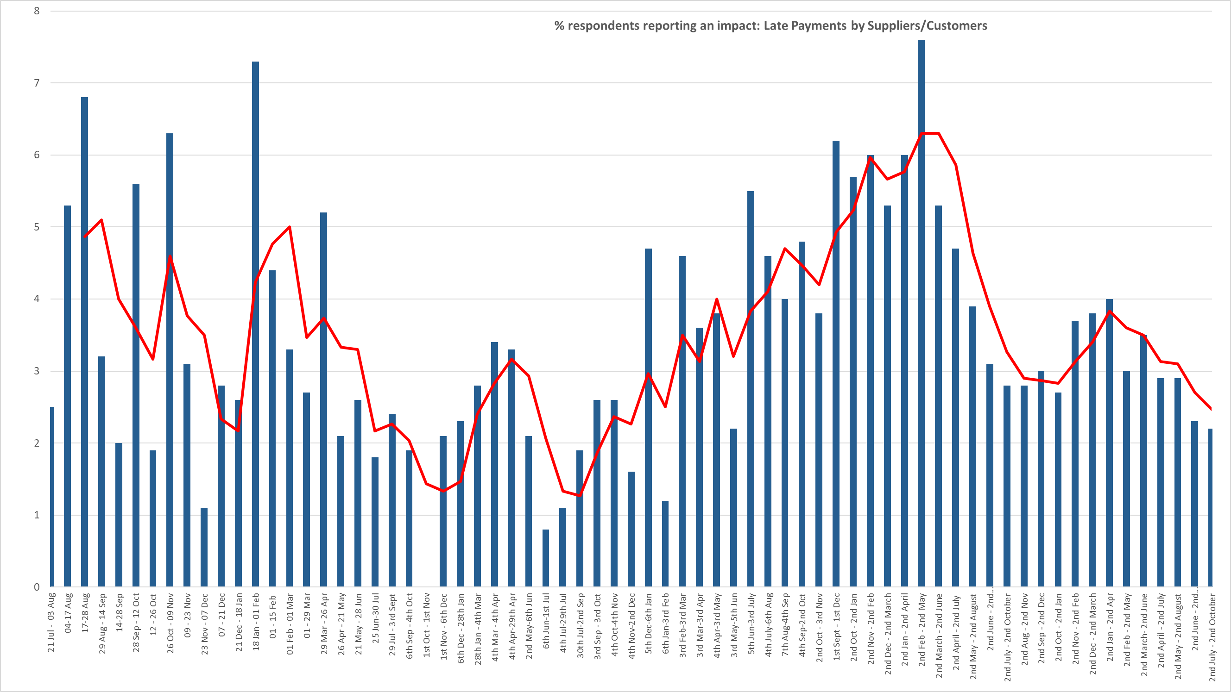
TIME SERIES OF THE MAIN IMPACTS OF ECONOMY ON BUSINESS
Percentage reporting decreased sales (Red line = moving average) | Percentage reporting increased sales
Percentage reporting rising costs | Percentage reporting late payments

Slide 23
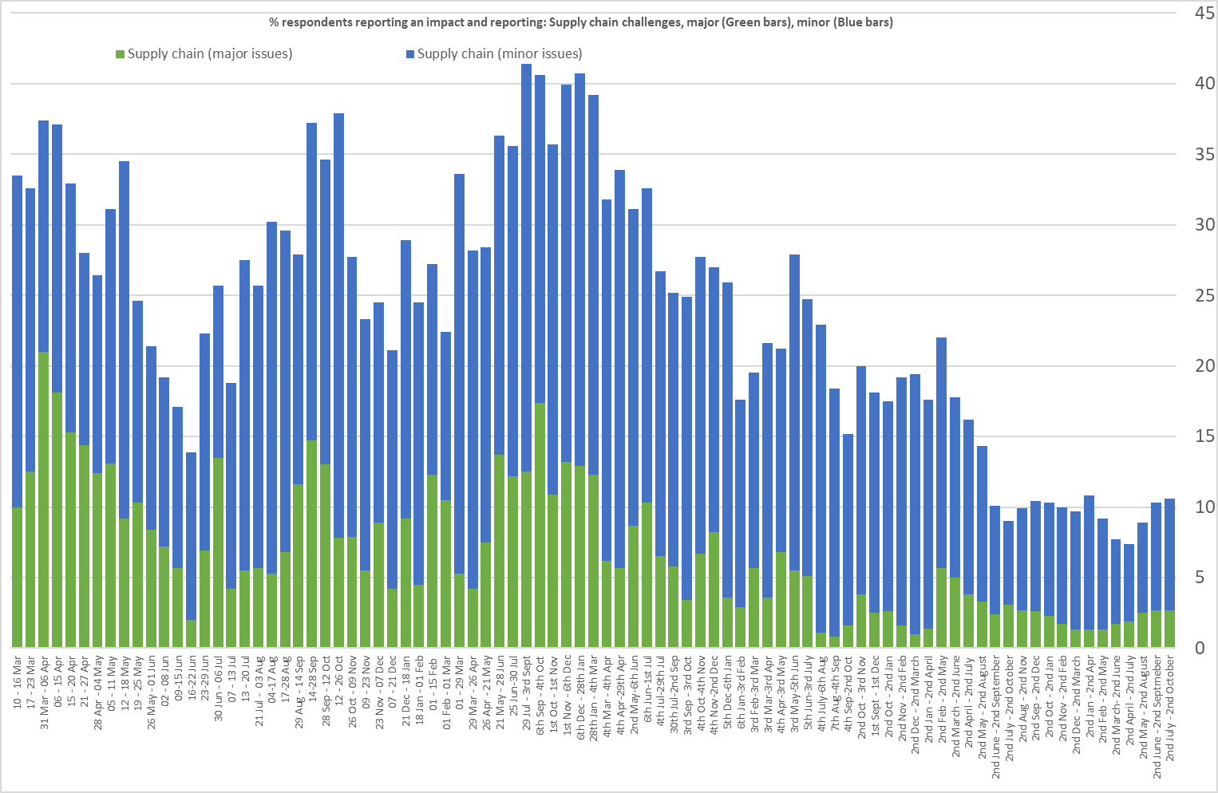
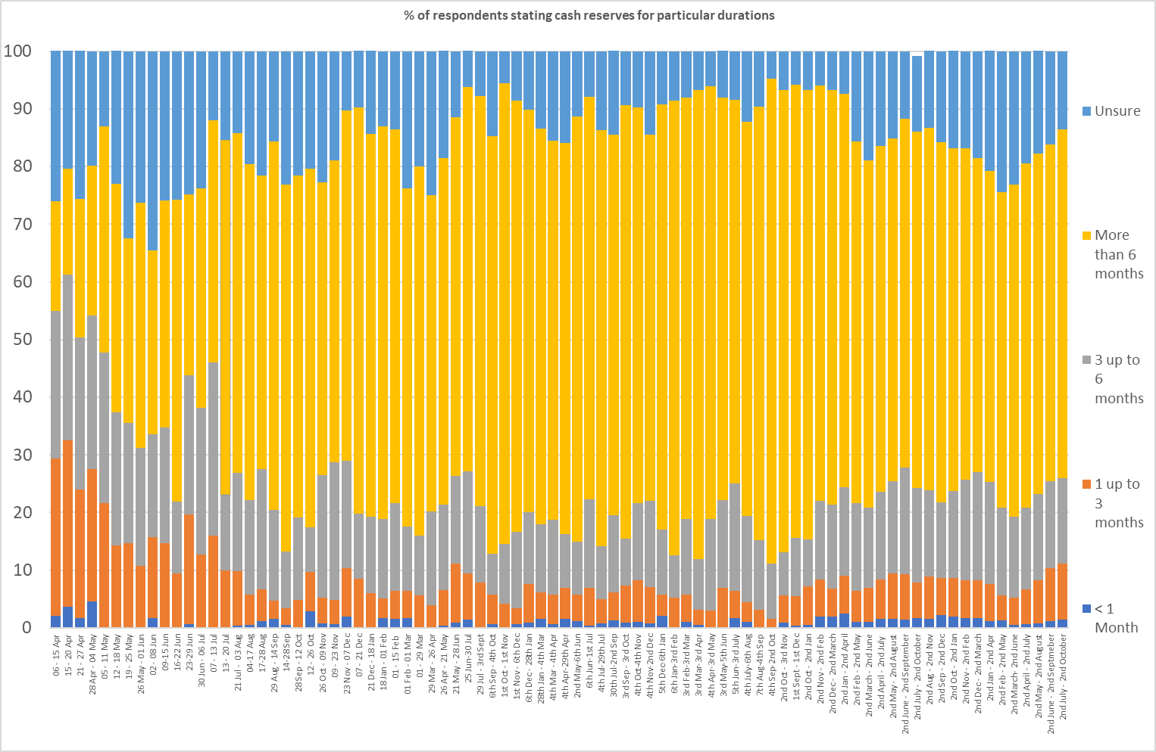
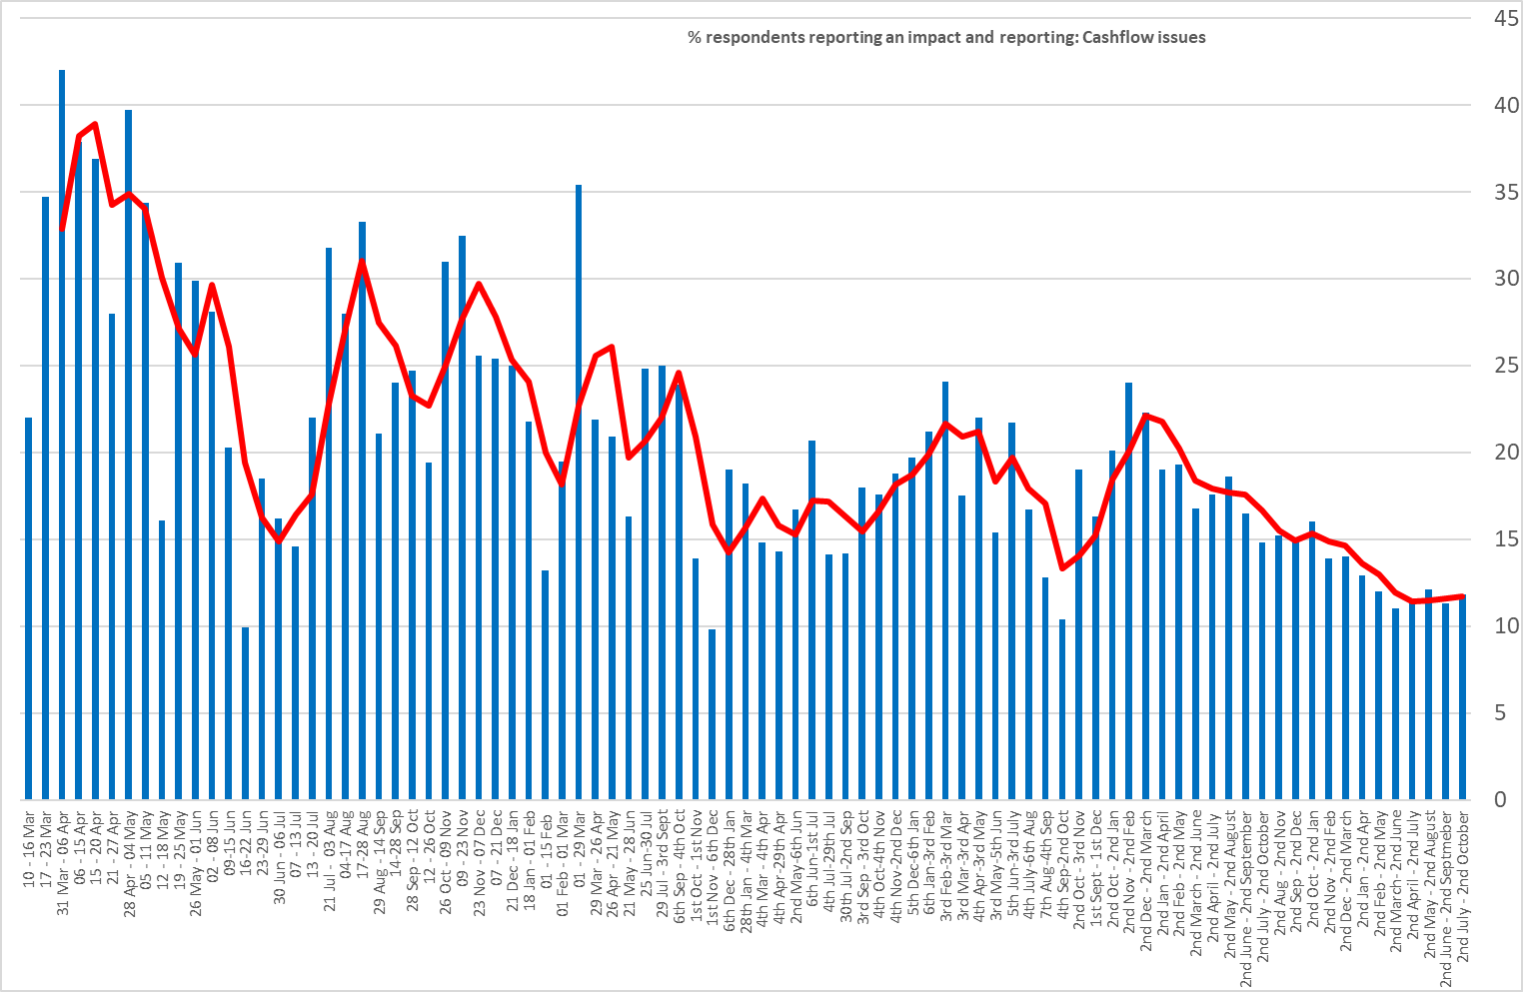
TIME SERIES OF THE MAIN IMPACTS OF ECONOMY ON BUSINESS
Percentage reporting minor supply chain issues (blue), major issues (green) | Aggregate confidence index – 1 low confidence, 10 high confidence
Percentage stating cash reserves can sustain certain periods of time | Percentage reporting cash flow problems

Slide 24
ANNEX: RESPONSE RATES
Size / Sector (as identified by the business) C = Confidential, 5 or less responses Percentages rounded to nearest figure | GM ONS IDBR | SEP 2025 | AUG 2025 | JUL 2025 | JUN 2025 | MAY 2025 | APR 2025 | MAR 2025 | FEB 2025 | JAN 2025 | DEC 2024 | NOV 2024 | OCT 2024 | SEP 2024 | AUG 2024 | JUL 2024 | JUN 2024 | MAY 2024 | MAR 2024 | FEB 2024 | JAN 2024 | DEC 2023 | NOV 2023 | OCT 2023 | SEP 2023 | AUG 2023
Size-band (employees) | % | % | % | % | % | % | % | % | % | % | % | % | % | % | % | % | % | % | % | % | % | % | % | % | % | %
‘0’ employment to 9 (MICRO) | 89% | 54% | 54% | 53% | 54% | 55% | 58% | 55% | 58% | 56% | 59% | 54% | 55% | 56% | 62% | 60% | 58% | 59% | 57% | 46% | 49% | 53% | 51% | 59% | 41% | 58%
10 to 49 (SMALL) | 9% | 22% | 25% | 24% | 24% | 24% | 24% | 25% | 24% | 23% | 20% | 24% | 25% | 26% | 24% | 23% | 24% | 24% | 26% | 27% | 22% | 13% | 20% | 16% | 24% | 16%
50 to 249 (MEDIUM) | 2% | 14% | 15% | 15% | 15% | 15% | 13% | 13% | 12% | 14% | 15% | 15% | 13% | 12% | 9% | 11% | 6% | 7% | 9% | 9% | 7% | 14% | 16% | 13% | 19% | 13%
250+ (LARGE) | <1% | 6% | 7% | 7% | 7% | 6% | 6% | 6% | 7% | 7% | 7% | 7% | 7% | 6% | C | 7% | 12% | 10% | 8% | 10% | 10% | 11% | 8% | 7% | 10% | 6%
UNKNOWN | - | 4% | - | - | - | - | - | - | C | C | C | C | C | C | C | C | C | C | C | 8% | 12% | 8% | C | C | 6% | 8%
AGRICULTURE, FORESTRY, FISHING | C | C | C | C | C | C | C | C | C | C | C | C | C | C | C | C | C | C | C | C | C | C | C | C | C | C
BUSINESS FINANCIAL, PROF. SERVICES | 27% | 9% | 9% | 11% | 12% | 13% | 13% | 14% | 13% | 13% | 12% | 12% | 12% | 12% | 10% | 8% | 10% | 10% | 10% | 13% | 14% | 14% | 18% | 11% | 22% | 15%
CONSTRUCTION | 12% | 6% | C | 6% | C | C | C | C | C | C | 6% | 6% | C | C | C | C | C | C | 6% | C | C | C | C | C | C | C
DIGITAL, CREATIVE, TECHNOLOGY | 6% | 19% | 19% | 19% | 18% | 18% | 19% | 21% | 23% | 23% | 24% | 25% | 24% | 21% | 21% | 22% | 18% | 16% | 13% | 18% | 19% | 22% | 23% | 23% | 24% | 23%
EDUCATION | 2% | 5% | C | C | 6% | 6% | C | C | 6% | C | 8% | 9% | 8% | 6% | C | C | C | C | C | C | C | C | C | C | C | C
ENGINEERING | 2% | 2% | C | C | C | C | C | C | C | C | C | C | C | C | C | C | C | C | C | C | C | C | C | C | C | C
UTILITIES, ENERGY, WATER, WASTE, GREEN TECH | C | C | C | C | C | C | C | C | C | C | C | C | C | 6% | 6% | 6% | 7% | 8% | 10% | 6% | 7% | C | C | C | C | 8%
HEALTH & SOCIAL CARE | C | 8% | 9% | 8% | 7% | C | 7% | 7% | 6% | C | C | 6% | 7% | 9% | 9% | 8% | 8% | 7% | 8% | C | C | C | 6% | C | 6% | C
HOSPITALITY, TOURISM, & SPORT | 7% | 4% | C | C | C | C | C | C | C | C | C | C | C | C | 6% | 7% | 6% | 7% | C | C | 5% | 7% | 6% | 10% | C | 8%
LOGISTICS | 5% | C | C | C | C | C | C | C | C | C | C | C | C | C | C | C | C | C | C | C | C | C | C | C | 6% | C
MANUFACTURING (excluding Engineering) | 3% | 16% | 18% | 19% | 19% | 18% | 18% | 18% | 17% | 15% | 13% | 12% | 13% | 13% | 15% | 17% | 16% | 16% | 21% | 26% | 20% | 19% | 18% | 19% | 17% | 22%
LIFE SCIENCES | N/A | 4% | C | C | C | C | C | C | C | C | C | C | C | C | C | C | C | C | C | C | C | C | C | C | C | C
RETAIL & WHOLESALE | 18% | 6% | 6% | 6% | 6% | C | C | C | C | C | C | C | C | C | 6% | 7% | 9% | 9% | 9% | 9% | 11% | 8% | 7% | 9% | C | 6%
OTHER SERVICES (excluding SIC unknown) | 4% | 12% | 12% | 12% | 12% | 7% | 7% | 11% | 7% | 6% | 6% | C | 6% | 6% | 8% | 6% | C | C | C | C | C | C | C | C | C | C

Slide 25
Q&A

Slide 26
Panel Discussion
Panel Host:
Colin Brew – Head of Strategic Partnerships - The Growth Company
Panellist:
Susana Cordoba – Head of International Services – The Growth Company
Chris Fletcher - GM LSIP Director and Policy Director - GM Chamber
Mark Hughes - Group Chief Executive – The Growth Company

Slide 27
The Greater Manchester Economic Update Event

